Slide 1
Organ Transplantation in Judaism
Limmud 2018
Anthony Warrens DM PhD FRCP FRCPath PFHEA
Dean for Education
Professor of Renal and Transplantation Medicine
Barts and The London School of Medicine and Dentistry
Queen Mary University of London

Slide 2
Outline of talk
The value of transplantation
The Jewish position in principle
The shortage of organs
  Deceased donation
  Living donation
Challenges in Jewish law

Slide 3
Transplantation in the UK, 2014-15
 | Deceased | Living
Cornea | 2860
Kidney | 2053 | 1045
Liver | 829 | 36
Pancreas | 202
Heart | 180
Lung | 185
Intestinal | 24

Slide 7
What are the benefits of kidney (renal) transplantation?

Slide 8
Kidney failure
Incompatible with life
The alternative is “renal replacement therapy”
  Dialysis
  Transplantation

Slide 9
Quality of life on renal replacement therapy
“Time trade-off” method
    0 = death; 1 = perfect health
  dialysis patients average score: 0.41
  transplant patient average score: 0.74
  27% increase in employment rate

Slide 10
Benefits of renal transplantation
Improved life expectancy
Improved quality of life

Slide 11
Benefits of transplantation of other organs
Cornea: sight-restoring
Liver: life-preserving
Heart: life-preserving
Lung: life-preserving

Slide 12
Why might Judaism not support organ donation?
Deceased donors
  Nivul ha’met: prohibition of mutilating a dead body
  Halanat ha’met: prohibition of delaying burial
  Hana’at ha’met: prohibition of deriving benefit from a body
  Definition of death

Slide 13
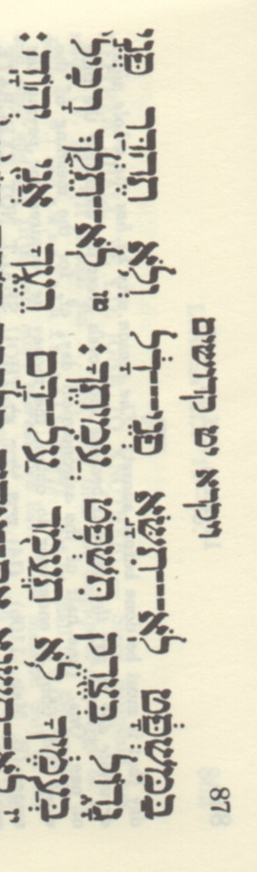
The Jewish attitude to transplantation
Liver: Life-preserving
Heart: Life-preserving
Lung: Life-preserving
Kidney: Life-prolonging
Hence, all covered within halachic parameters of pikuach nefesh
Pikuach nefesh supersedes nivul hamet, halanat ha’met and hana’at ha’met

Slide 14
The Jewish attitude to transplantation
Additional problems with transplantation
  Halachic principle of suspending laws because of pikuach nefesh is restricted to an ill person who is
  “at hand” (choleh lefaneinu)
  Corneas can be stored until needed
  Other organs are not stored, but are they removed before recipient is chosen
  Many authorities accept that the demand is such that we can be certain that a recipient will be “at hand”

Slide 15
Benefits of transplantation of other organs
Cornea: Sight-restoring
Rabbinic consensus is that blindness is life-threatening, thus we can invoke the principle of pikuach nefesh
Harder to justify corneal transplantation for unilateral blindness on basis of pikuach nefesh
  Some responsa still permit

Slide 16
Baseless considerations
‘The evil eye’
Need for intact bodies for the resurrection of the dead
Premature discontinuation of therapy in order to generate supply of organs

Slide 17
Why not offer a transplant to everyone who could benefit from one?

Slide 19
Where do donated organs come from?

Slide 20
The deceased donor
The live donor

Slide 21
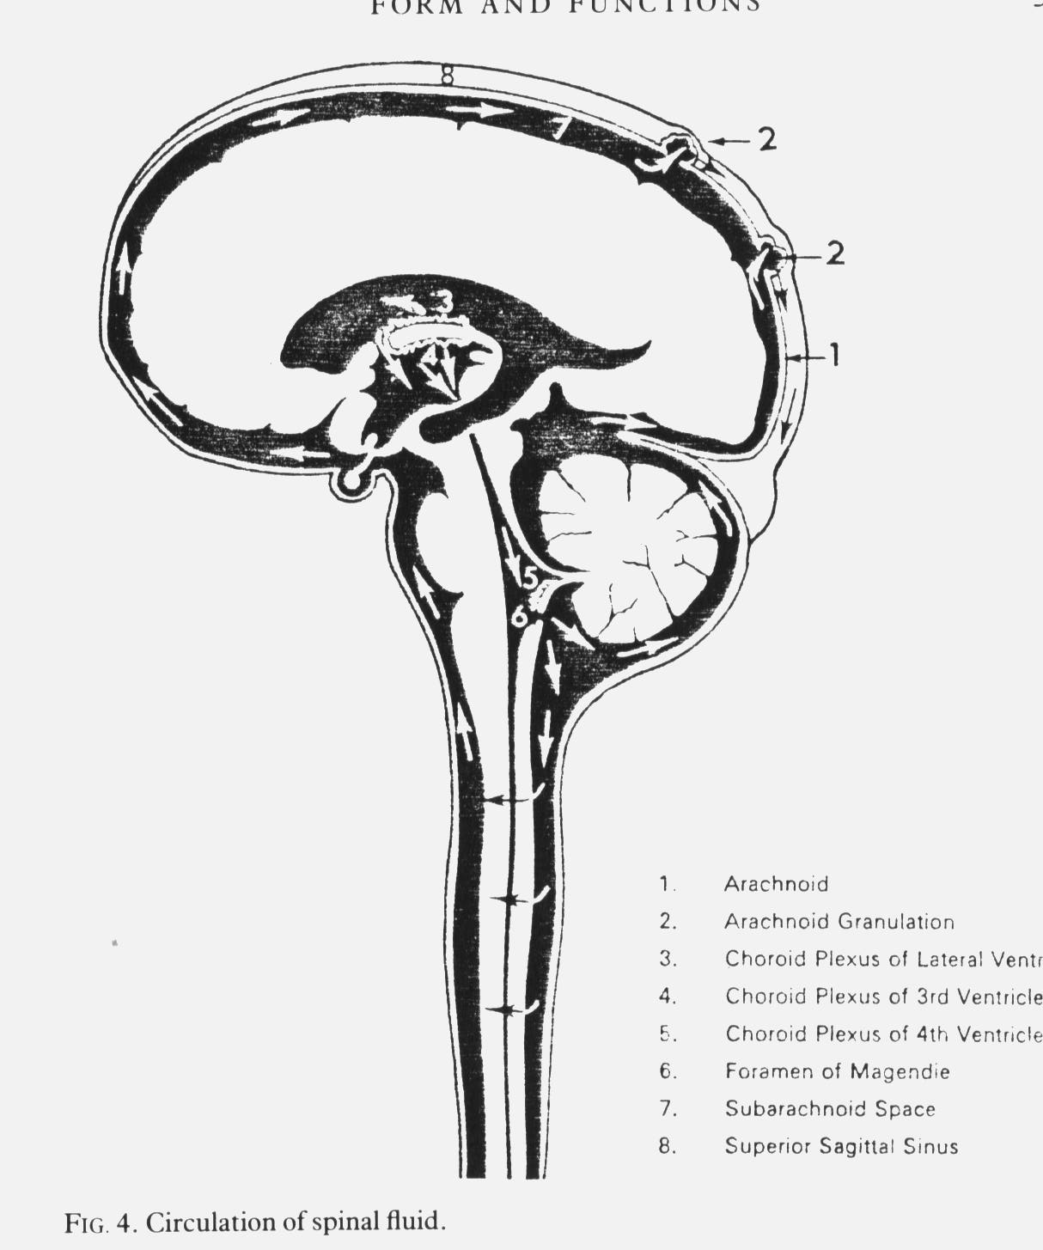
The Central Nervous System
Cerebral hemispheres
Brain stem
Spinal cord

Slide 22
The deceased donor
“Brain stem dead”
  usually intracranial haemorrhage or head injury
  criteria
    irremediable structural brain damage of KNOWN cause
    demonstrate, over a period of time, lack of brain stem function
      Absent consciousness
      No spontaneous breathing
  no prospect of recovery
  Advantage:
    heart and lungs still working but only while on a life-support machine
    organs are transplanted in good condition

Slide 23
The deceased donor
“Brain stem dead”
  A very particular type of ‘coma’
  Very different from “persistent vegetative state”

Slide 24
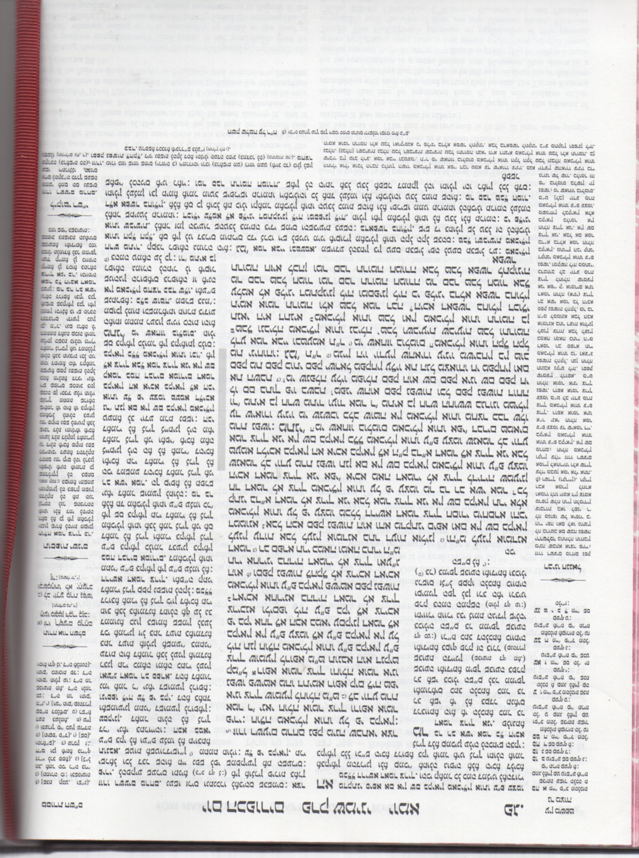
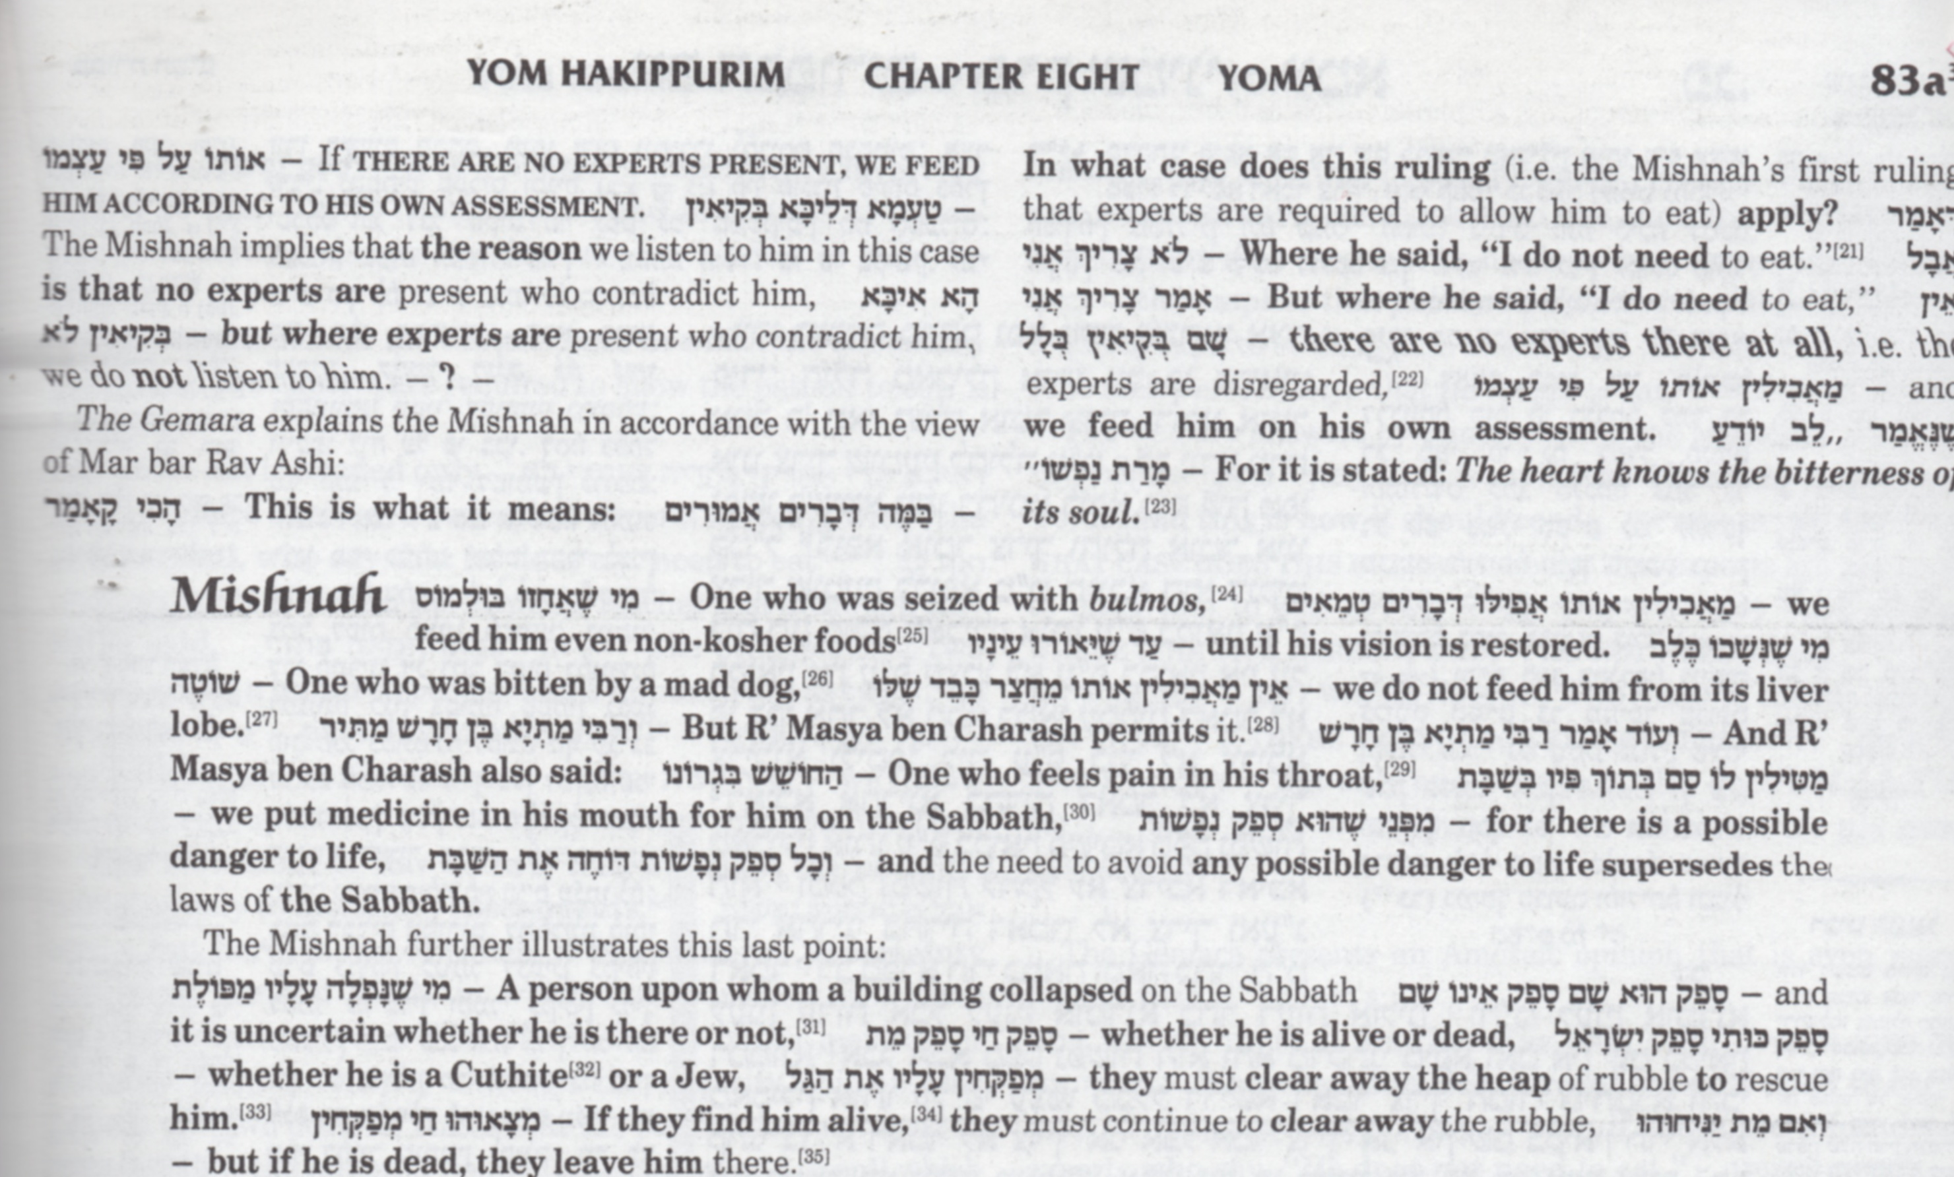
Judaism and brain stem death

Slide 25
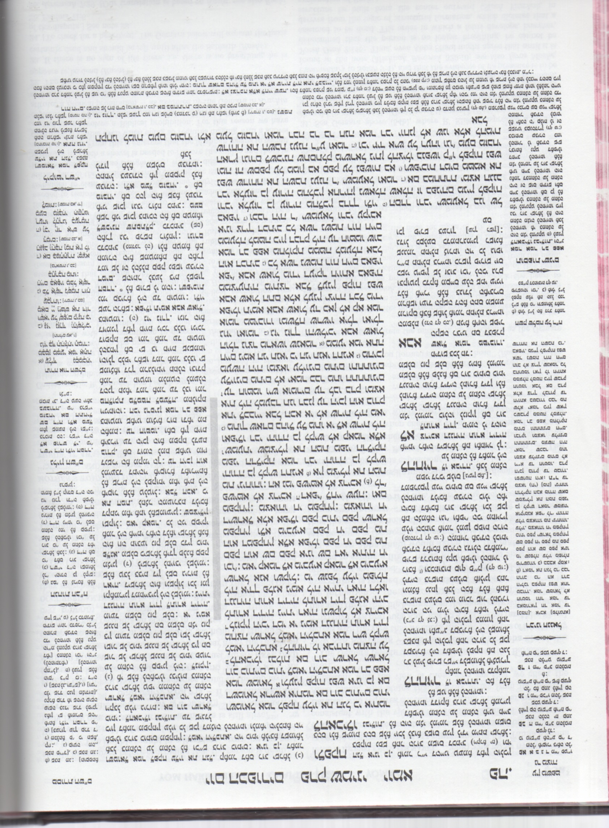
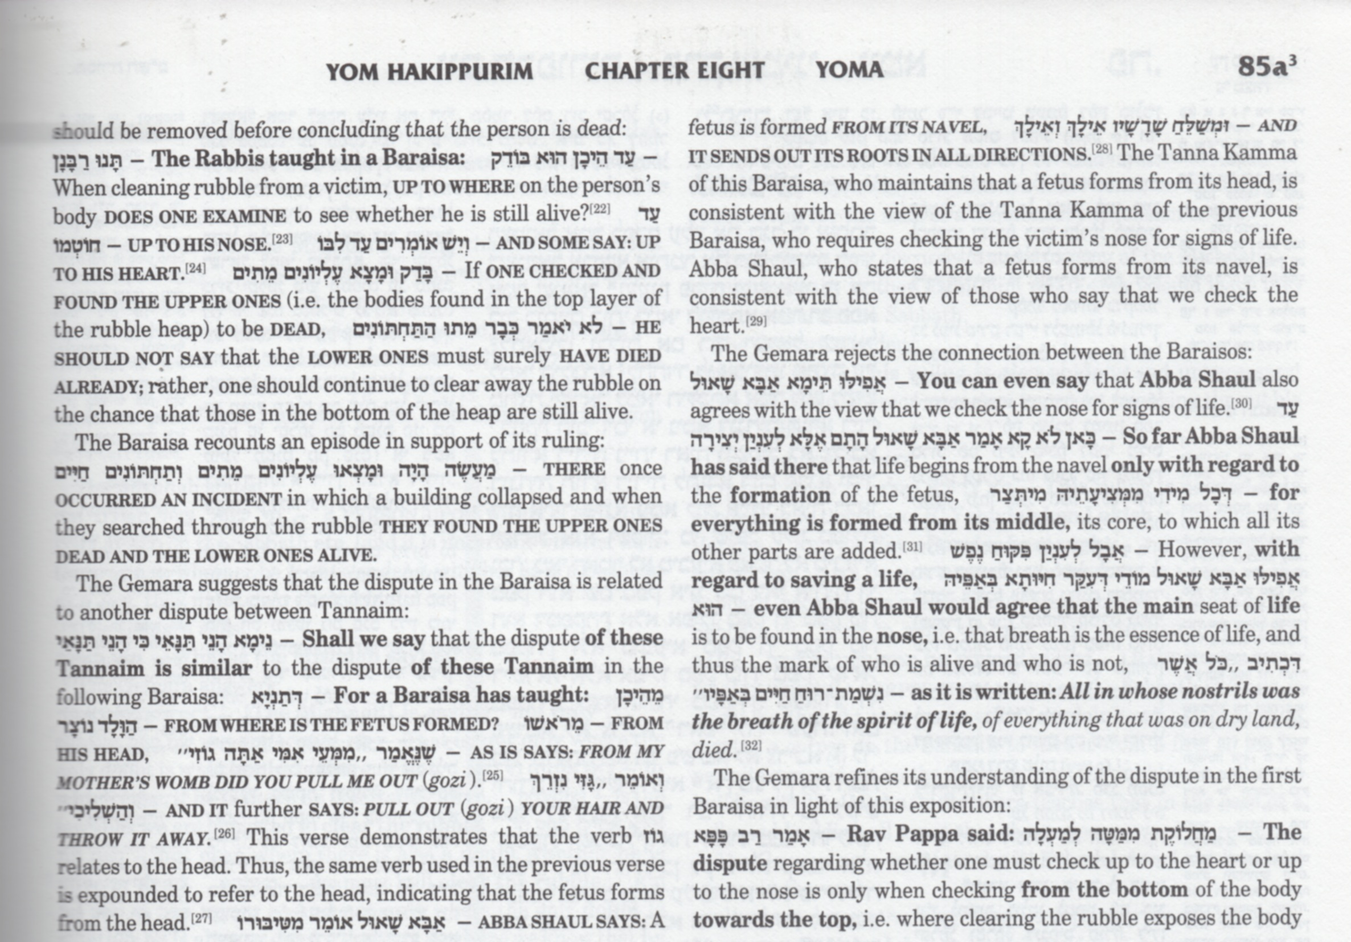
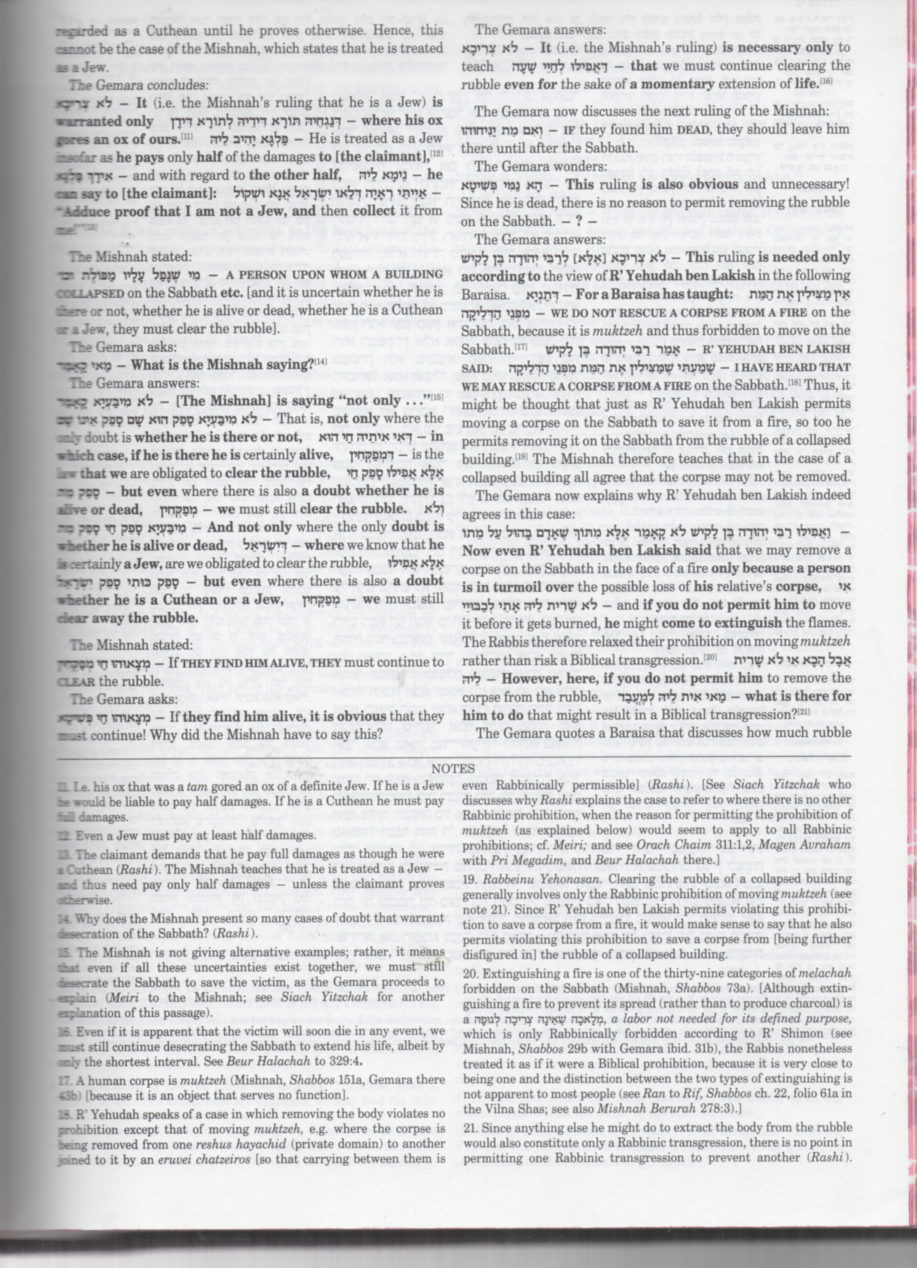
Judaism and brain stem death

Slide 26
Judaism and brain stem death

Slide 27
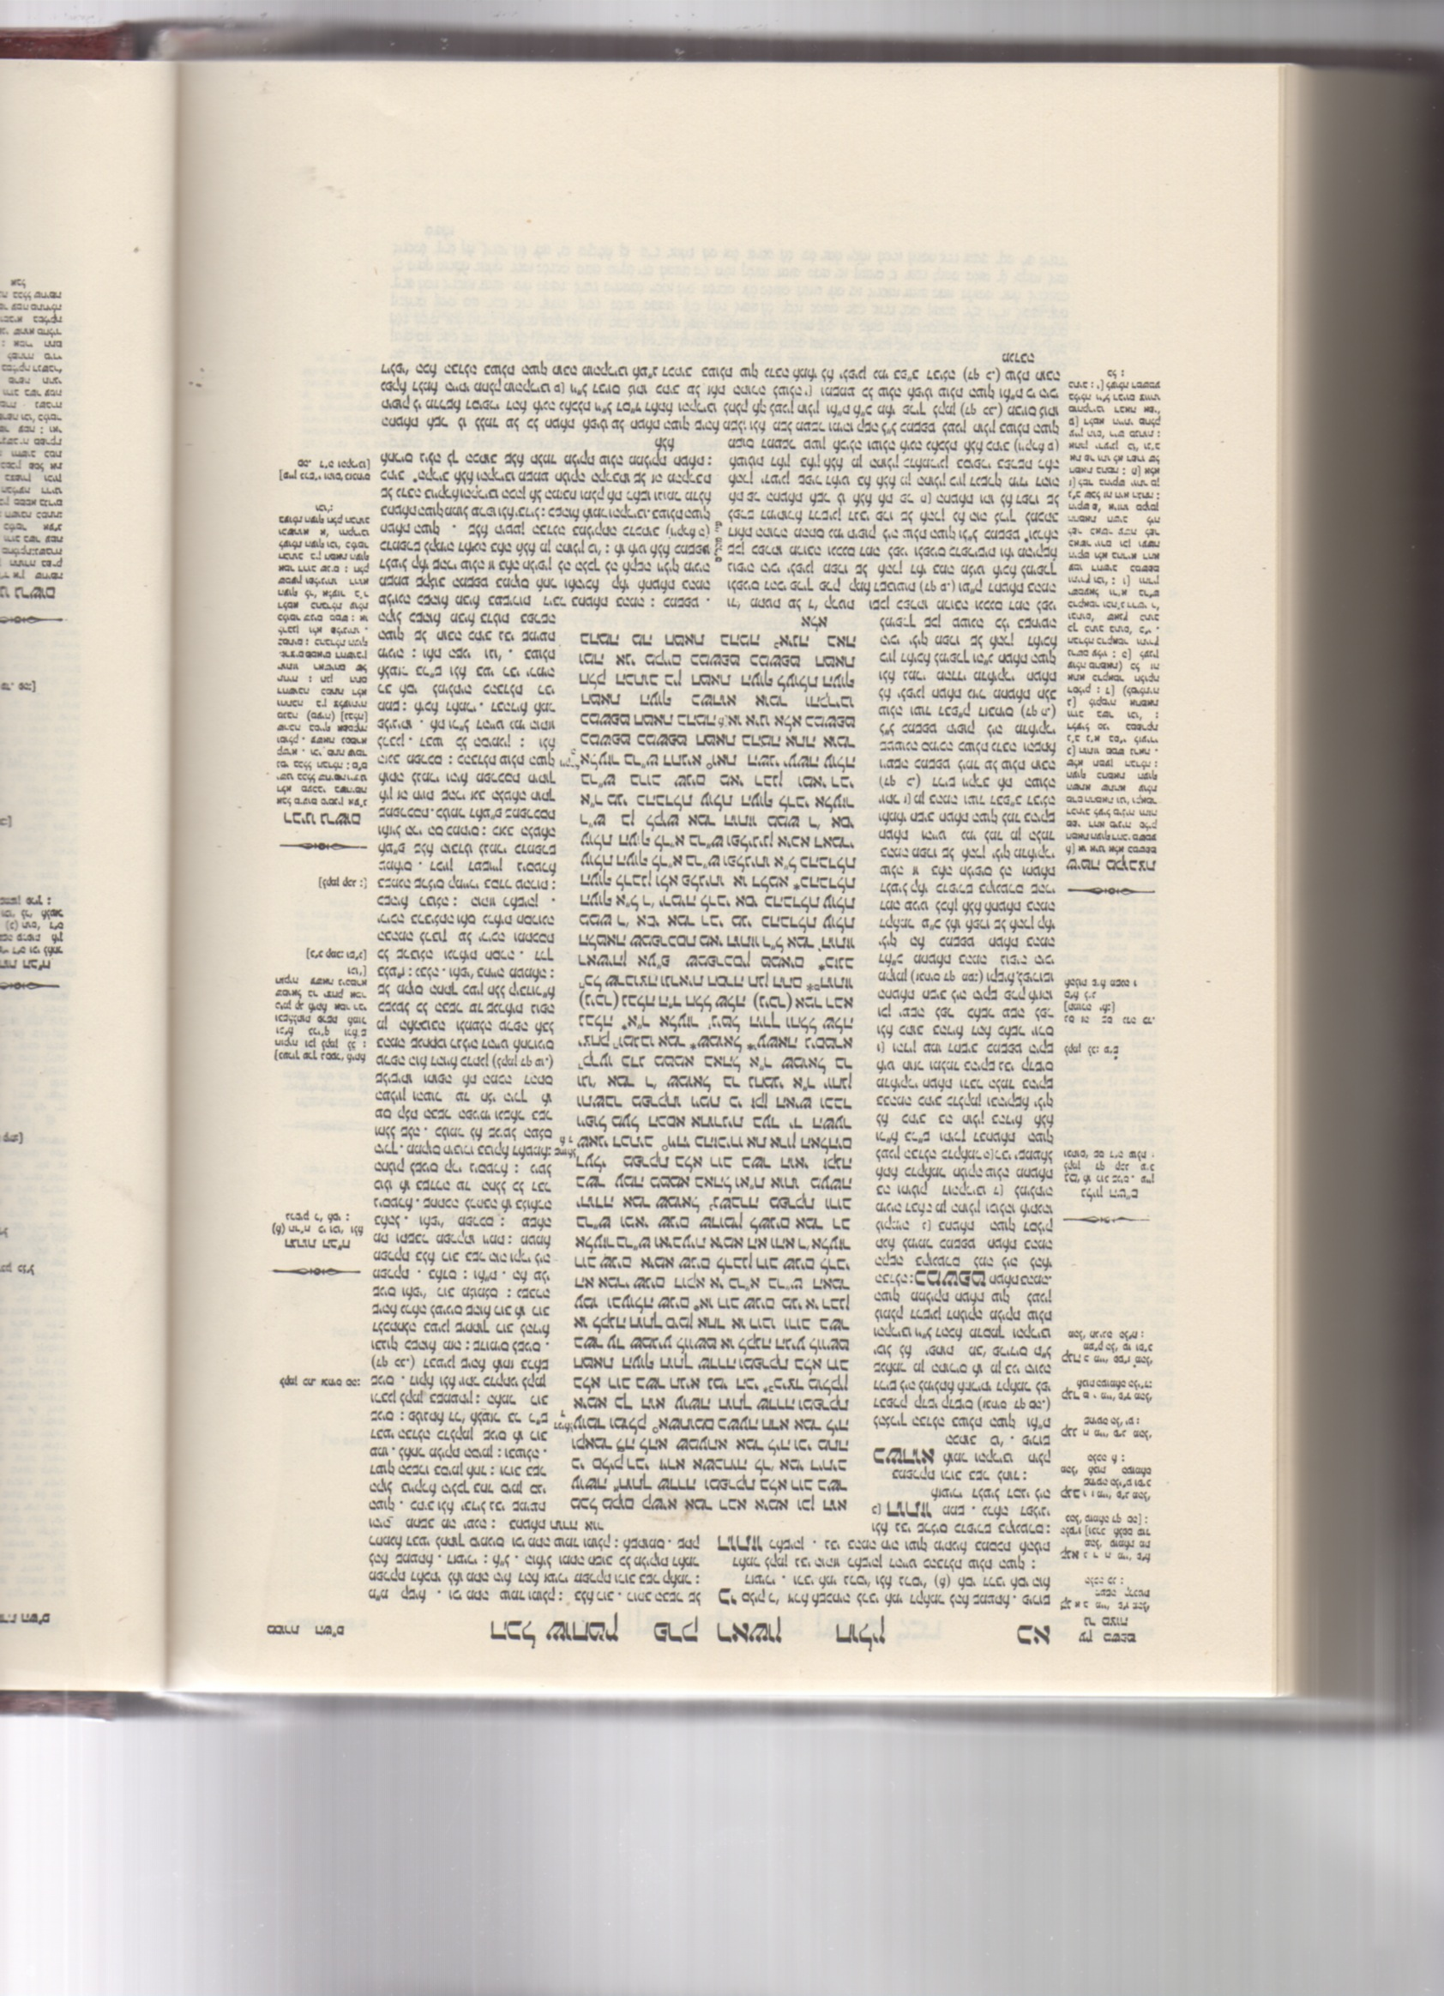
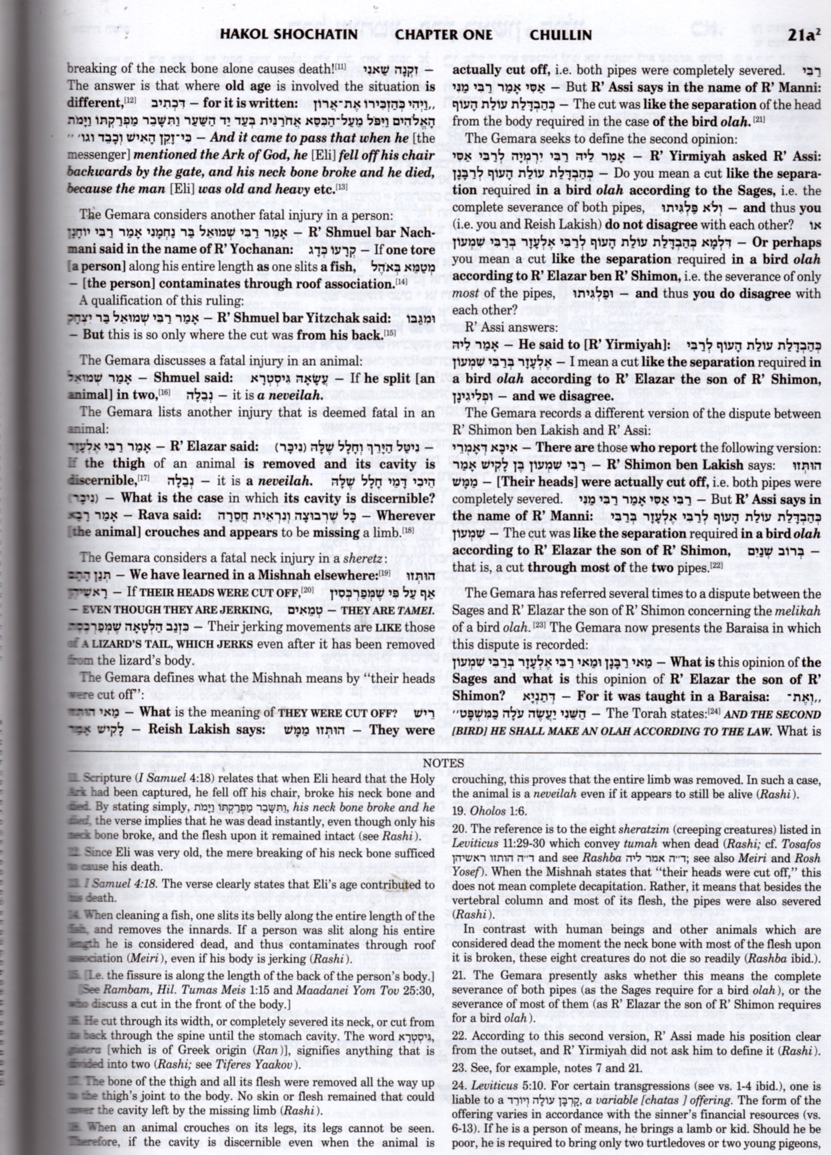
Judaism and brain stem death

Slide 28
Judaism and brain stem death
How do you define death?
  Classically cessation of heart and lung function
    Thus taking organs from a brain stem dead individual (as currently defined) is murder
  Other (orthodox) poskim accept brain stem death
So, according to halacha, are you allowed to:
  state that you wish to donate your organs if you become brain stem dead?
  consent to the donation of organs from a family member if he/she becomes brain stem dead?
  accept an organ removed from a brain stem dead person?

Slide 29
Judaism and brain stem death
Cessation of breathing is adequate definition
  Man buried under rubble on Shabbat
    Talmud, Shulchan Aruch, Rambam rule that one must dig until it is shown he is not breathing
    Others say a beating heart implies there is still some potential for life
  Several gedolei hador support using cessation of breathing, even if the heart is beating, as definition of death; others do not
  Chief Rabbinate of Israel (1986) accepted
  For how long must breathing have been stopped?

Slide 30
Judaism and brain stem death
If a person subscribes to the view that heart-beating donation is murder
  Should he ever accept such an organ if he needs it himself?

Slide 31
Is there an alternative to the brain stem dead donor?
Non-heart beating donor
  Organs may be used if taken within the first few minutes of heart stopping
  Advantage:
    Makes more individuals available as potential donors
    Circumvents problems of brain stem death
  Disadvantages:
    Very demanding on hospital services
    Organs do not fare quite as well

Slide 36
Strategies for reducing the shortfall
Decrease the demand for organs
  improve preventative and interventional therapy
Increase cadaveric donation
  donor card campaigns
  public information
  “presumed consent”
    donation rates highest in Spain, Austria and
    parts of Belgium
    Is this an infringement of civil liberties?
    Would it work in the UK?

Slide 39
Live kidney donation
Risks are very small
  Risk of donor death is 0.03%
Halachically, most poskim permit it
Obligation to help if we can:
  Al ta’amod bedam re’echa
  But generally not
  regarded as an
  obligation to donate

Slide 40
Live kidney donation
Maintaining an individual’s autonomy
  Family pressures to donate may be great
Anonymous altruistic donation
Paired and pooled donation:
  Two families: A and B
    Husband A is compatible with wife B but not his own wife
    Husband B is compatible with wife A but not his own wife

Slide 41
Conclusions
Transplantation is unquestionably life-saving
There are too few organs
There is agreement that live donation is permitted but not obligatory
There is no consensus about the use of brain-stem criteria to define death
Donation after death has been defined using circulatory failure is halachically acceptable
But there is clear consensus that, without more organs, three people a day in the UK – who could be treated – will die on the waiting list

